Slide 1
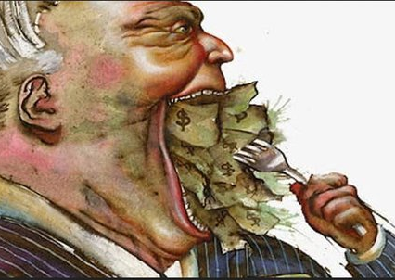

Capitalism
The Story of the Industrial Revolution

Slide 2
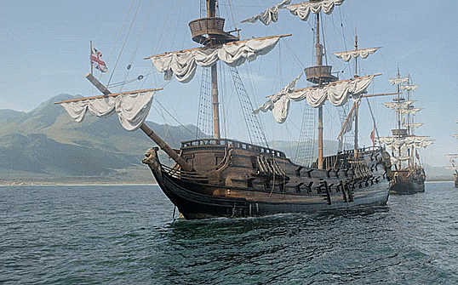


increased trade
Exports from India
Br. Privateers and merchants brought wealth
Middle class got mo’ money

Slide 3
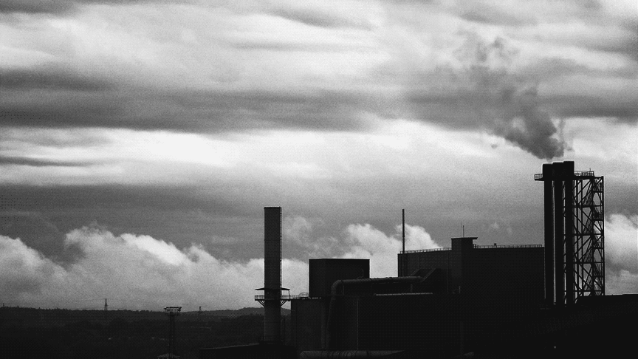

Big Industry
Production quicker and cheaper
Factories can be anywhere
Banks are involved in the loaning of a lot of money

Slide 4




Results?
Disease ravaged poor bums
Longer working hours
Lower wages
Infinite supply of workers
Women and children worked
(got paid less)
work
die

Slide 5


Any help please !
Parliament gave employers free reign
“lower classes must be kept poor or they will never be industrious.”
Parliament on employers’ side
Parliament watching employers work their staff to death

Slide 6




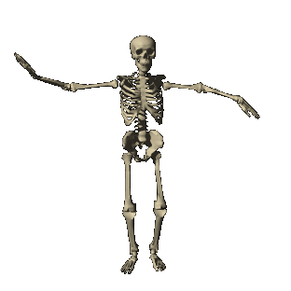
Guilds in the industrial revolution
The Death of guilds
Guilds not compete with industrials
Workers can’t help each other
Generations old shops closed down

Slide 7





Cya

